Slide 1

CMNS 3420 – 02 – Advanced Professional Communication – February 23, 2026
Illustration by Art Attack on Unsplash

Slide 2
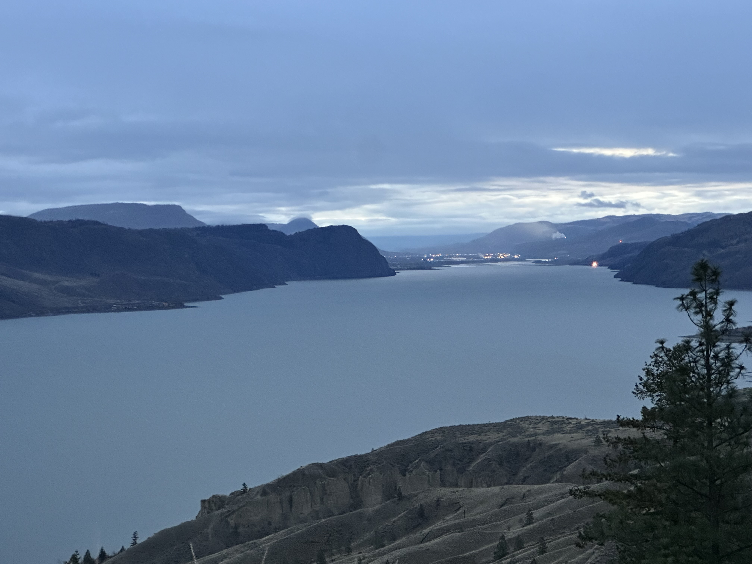
Territorial Acknowledgement

Slide 3
Where we’re going today
What is a policy brief?
Sample policy briefs
Preparing for Journal 4

Slide 4
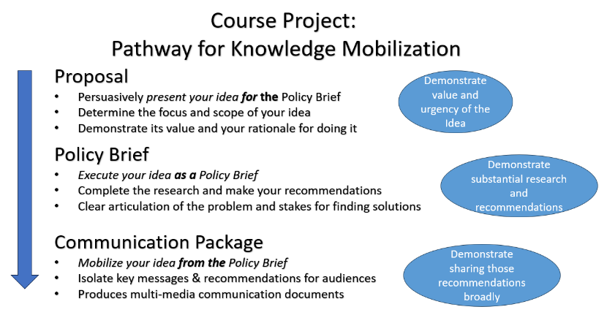

Slide 5
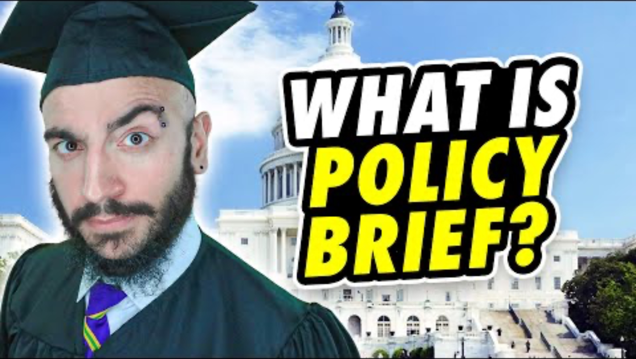
As you watch the video, consider the following: - What does he say a policy brief is not? - How is research used in a policy brief? - What does he mean that a policy brief is a “translational text?”
https://www.youtube.com/watch?v=pvupkji29ZU

Slide 6
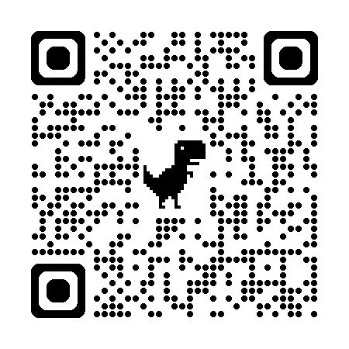
Exigence. What is the context/situation generating the need for the policy brief?
Focus. What is the Core question, issue or problem underlying the Policy Brief?
Purpose/Audience. What does this brief aim to do? What action or new knowledge does it generate? Who is it written for?
Value. What is the key value generated by the policy brief? Who benefits from this work? What is the call to action – what should happen next?
Perspective. What is the discourse community for this policy brief? What social perspective and ongoing conversation does it engage? (More on this in the section below).
Content. What content forms the substance of this policy brief? What kind of research does it use? What key points does it make?
Structure. How has the brief been organized? What are the key sections? How does the story of the brief develop step by step? (More on the storytelling of the brief later in this unit).
Design. Look closely at how the document has been put together. How many levels of headings are used? How is colour and layout used? How would you describe the tone of the brief? How are graphics used?
Look at your assigned policy brief
Do a quick sketch of the organization of the policy brief
Answer the questions to the right…

Slide 7
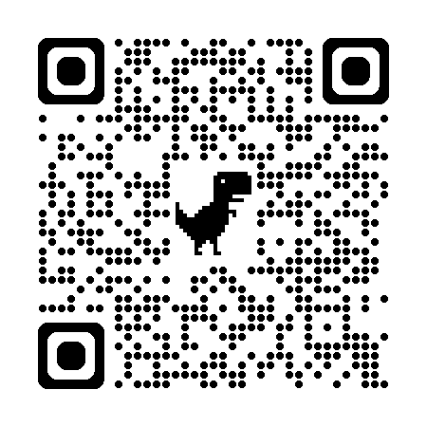
University of North Carolina’s Writing Centre Tips for writing effective policy briefs
Pay particular attention to the sections on “How do I identify a problem”
and “Framing the issue.”

Slide 8

Preparing for next class
Work through Unit 2, Section 1 (course website) for Wednesday
Be sure to go through the readings listed. They will become your “go-to” guides for the next month.
On Wednesday, we will work with the discourse community aspects of the policy brief
Wednesday will have time allotted to work on Journal Task 4 and to address questions you may have.

